Slide 1
ConvNet for NLP

Slide 2
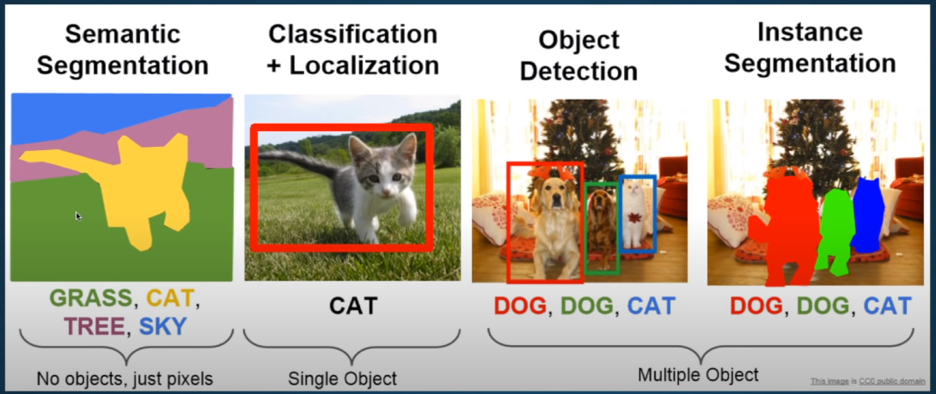
What is CNN or ConvNet

Slide 3
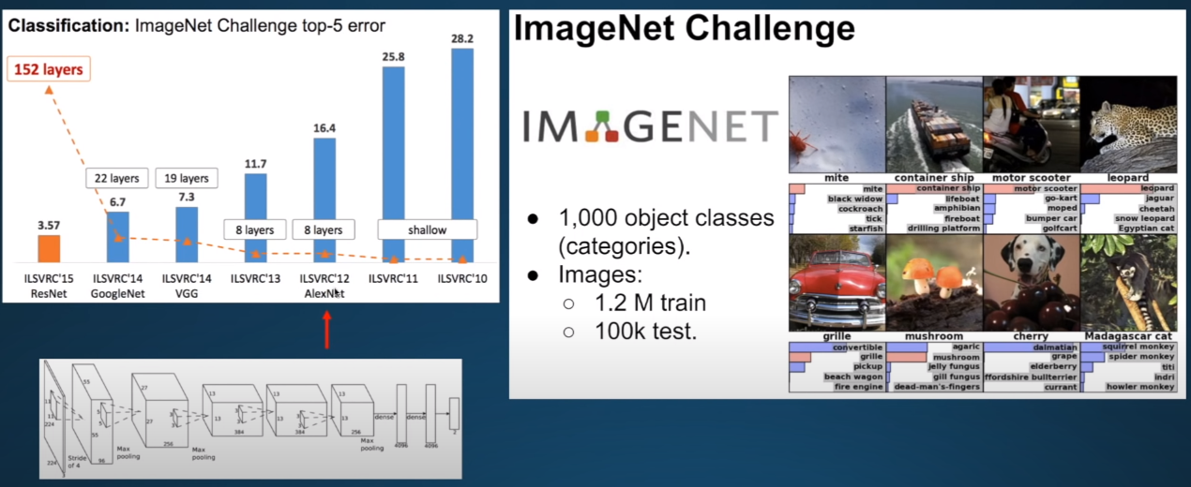
History of CNN

Slide 4
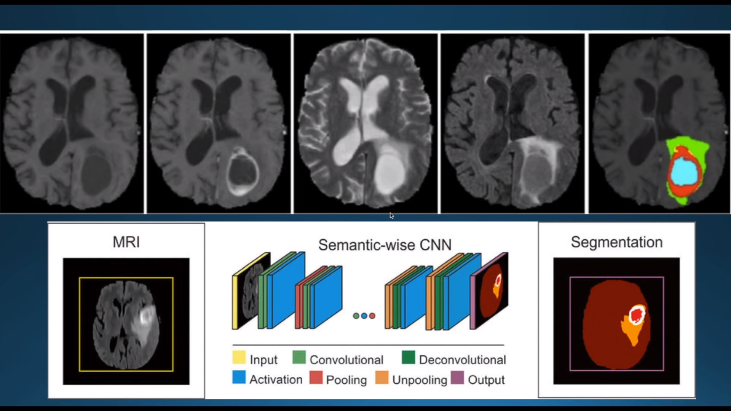
CNN outperforms human eyes (Doctors)

Slide 5
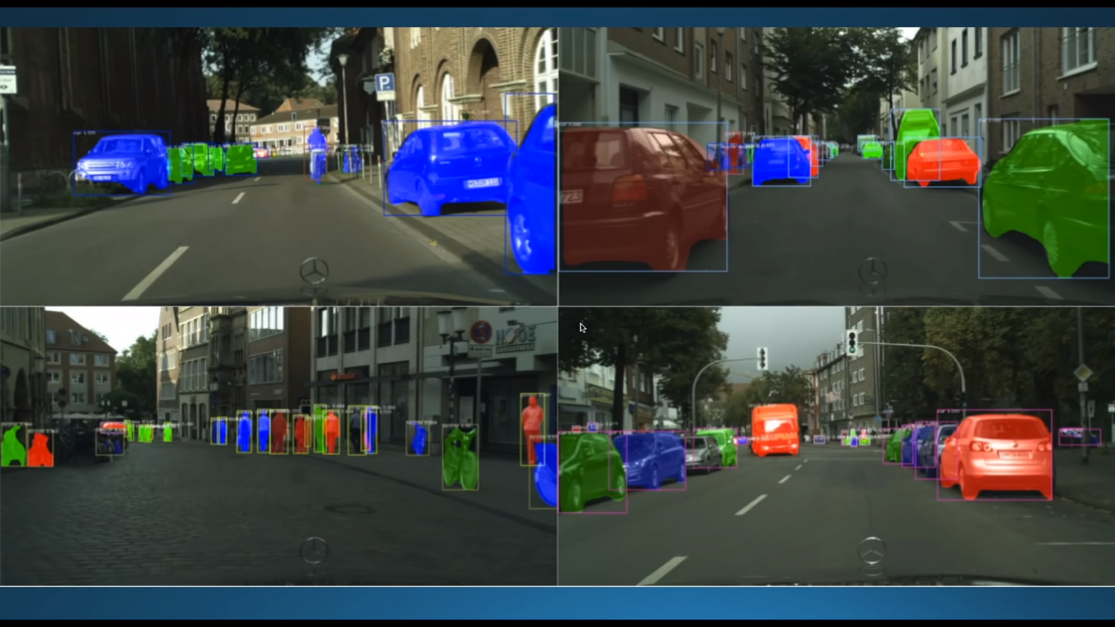
CNN for object detection

Slide 6
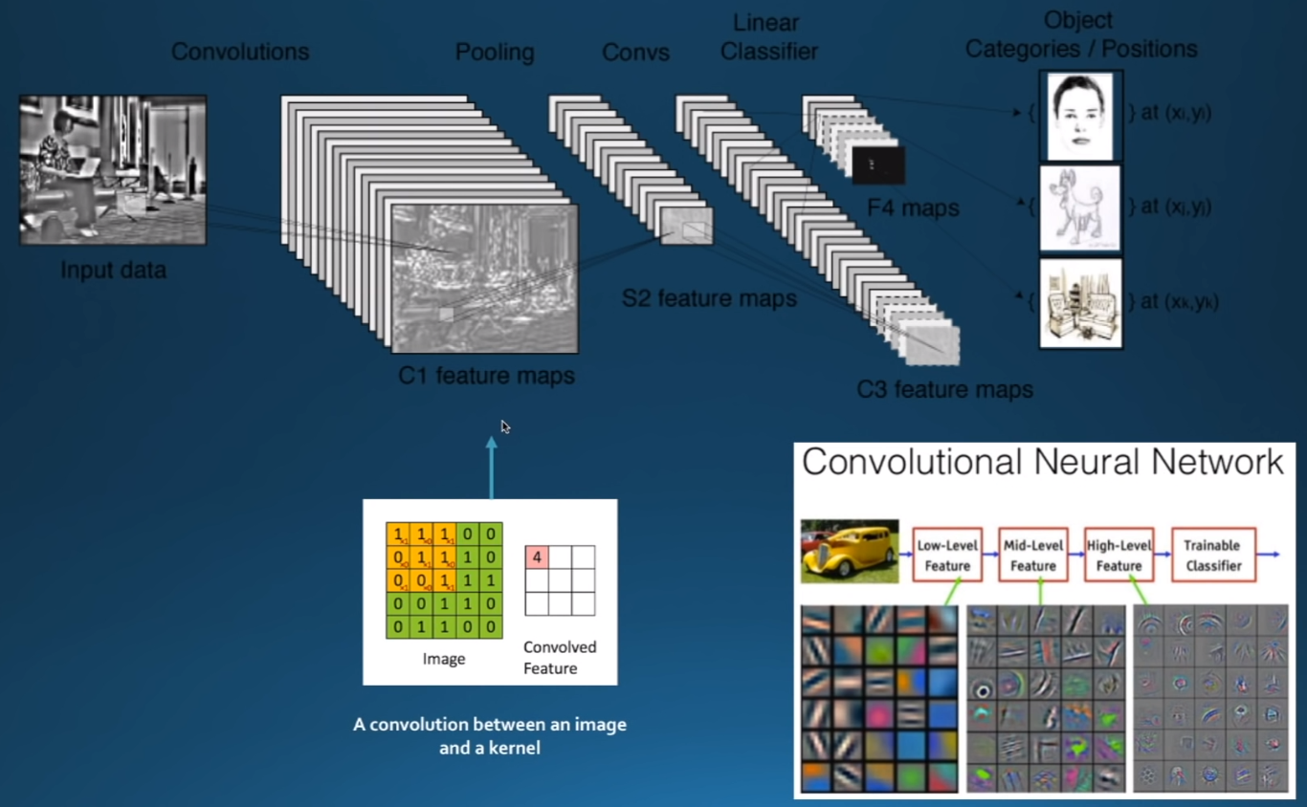
Conv Features

Slide 7
CNN for text

Slide 8
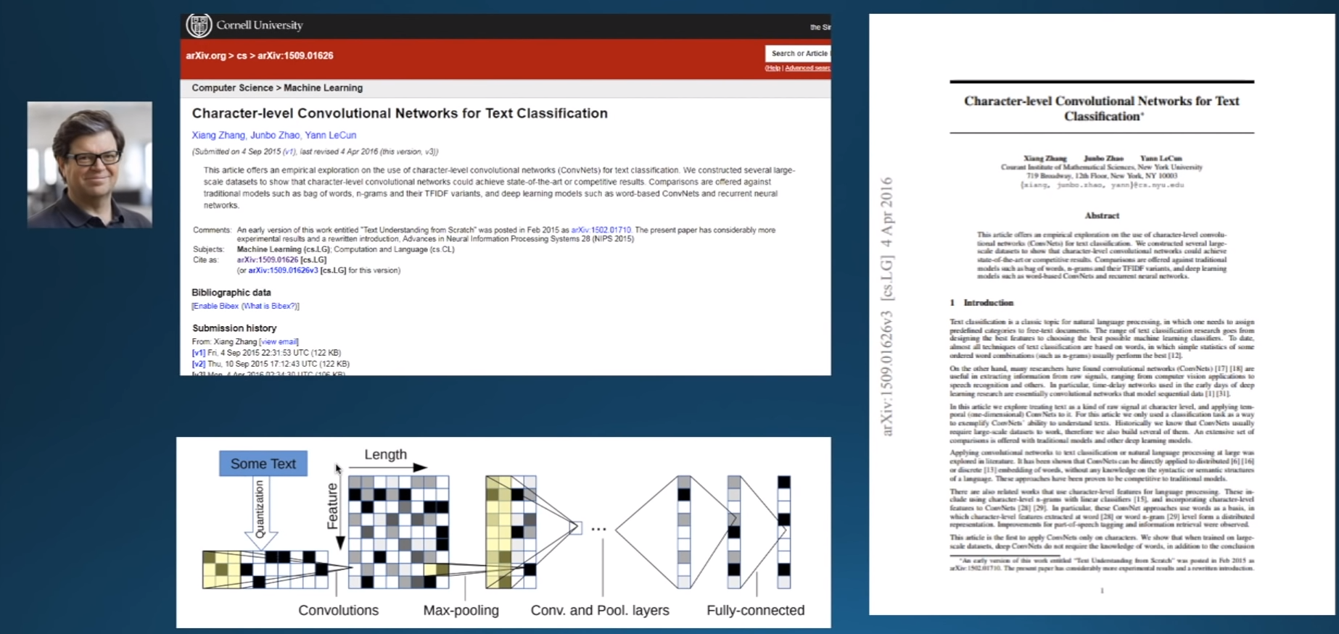
CNN for text

Slide 9
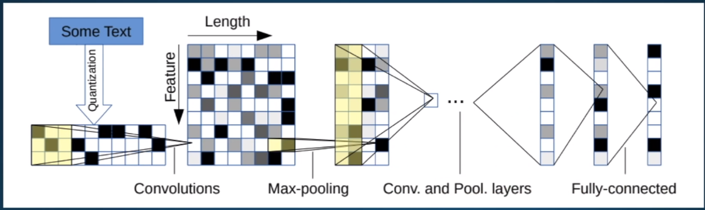
CNN for text

Slide 10
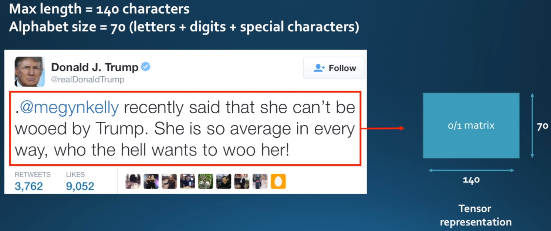
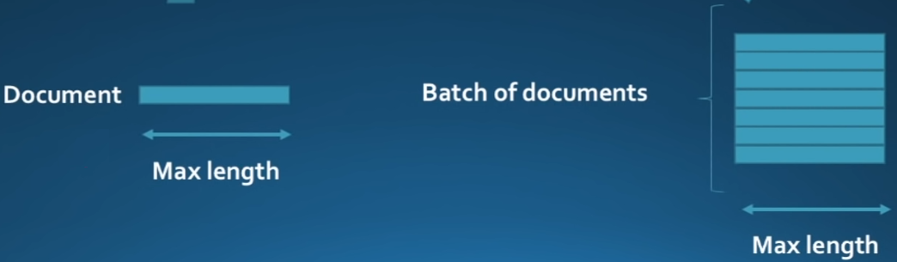
How?
Consider a tweet
Set Alphabet
Set Max Length

Slide 11
A tweet representation

Slide 12
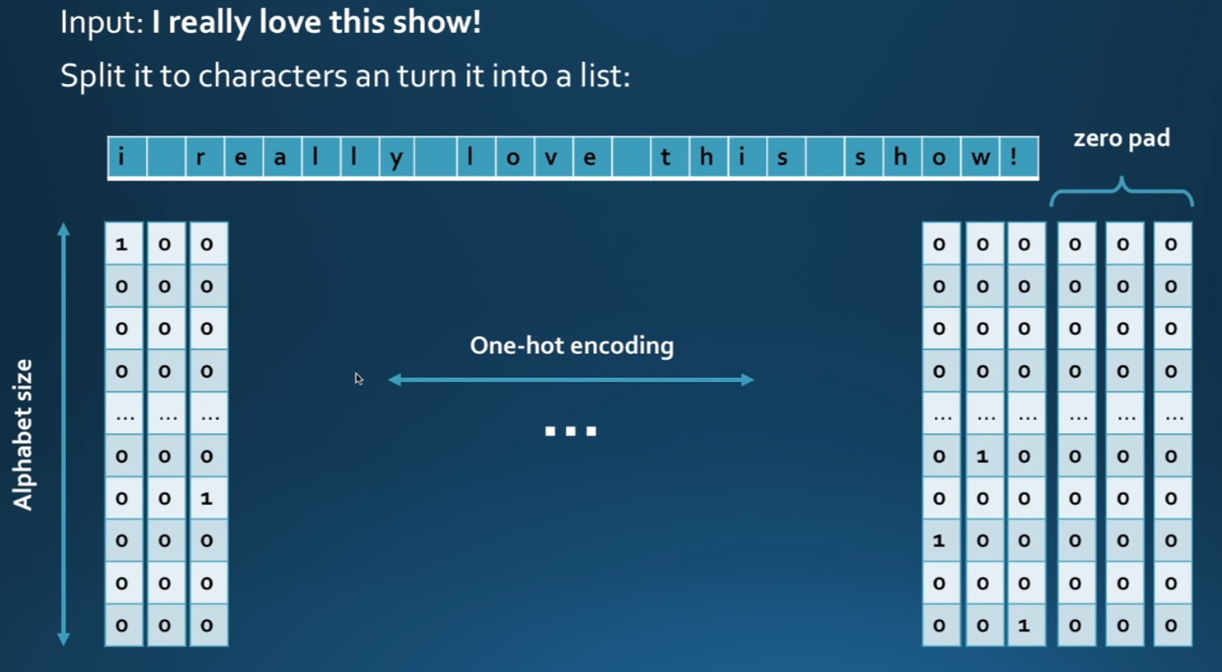

Slide 13
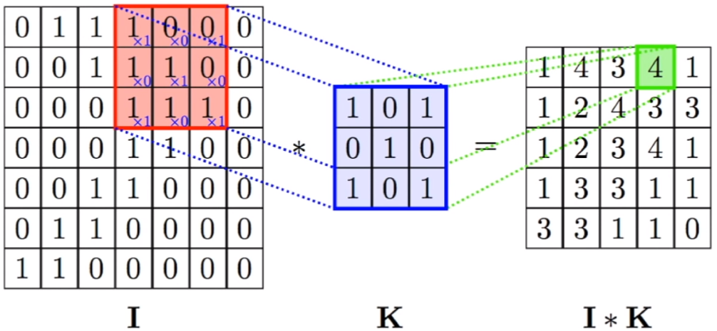
2D conv is not suitable for text

Slide 14
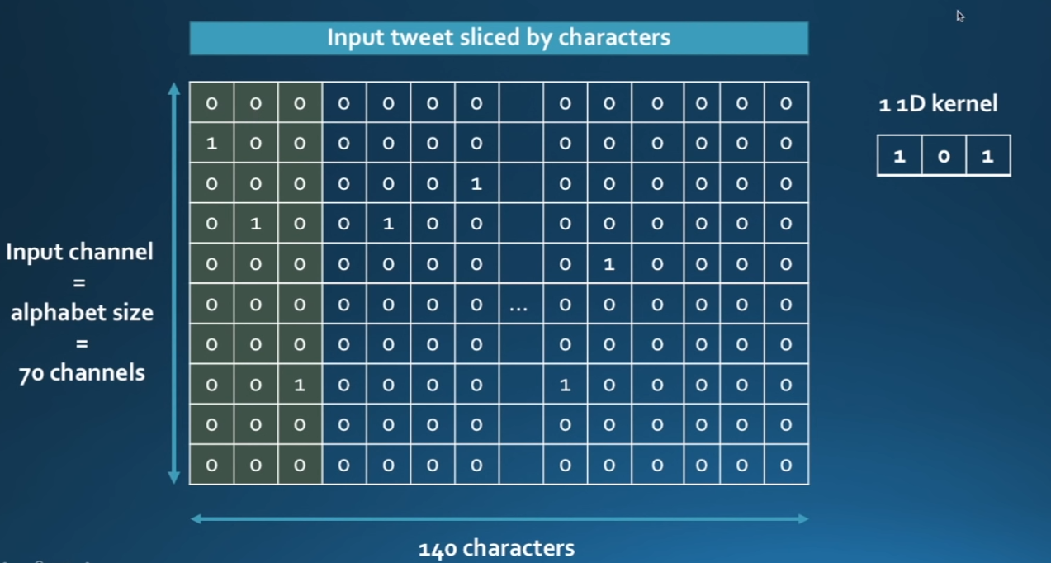
Use 1D Convolutions

Slide 15
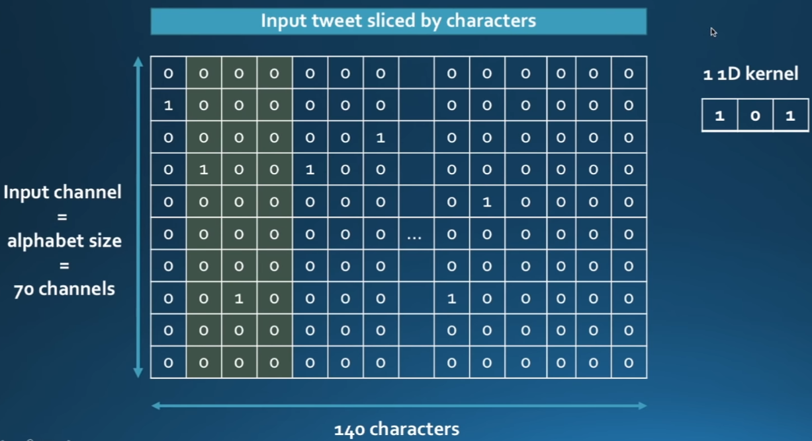
Use 1D Convolutions

Slide 16
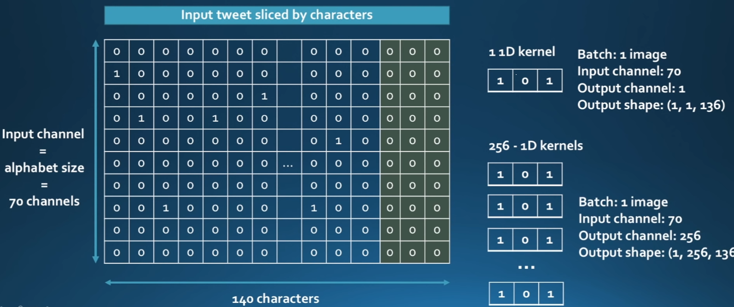
Use 1D Convolutions, 256 kernals

Slide 17
When to use Character level CNN for text classification
YES
If the data is noisy: tweets, SMS, slang, …..
If the data is large: over 1M doc
Advantages
No text preprocessing
Good handling for misspelled / out-of-vocabulary words (OOV)
Fast training
Small model sizes and low memory usage

Slide 18
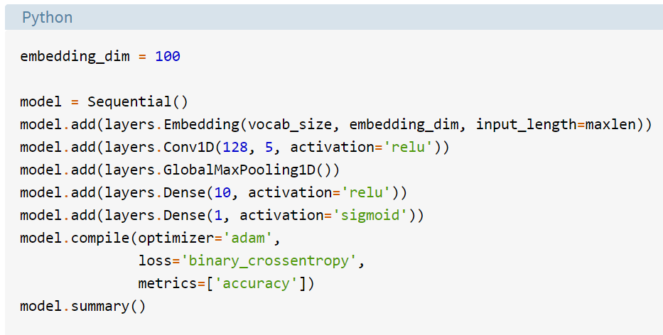
Some recipes

Slide 19
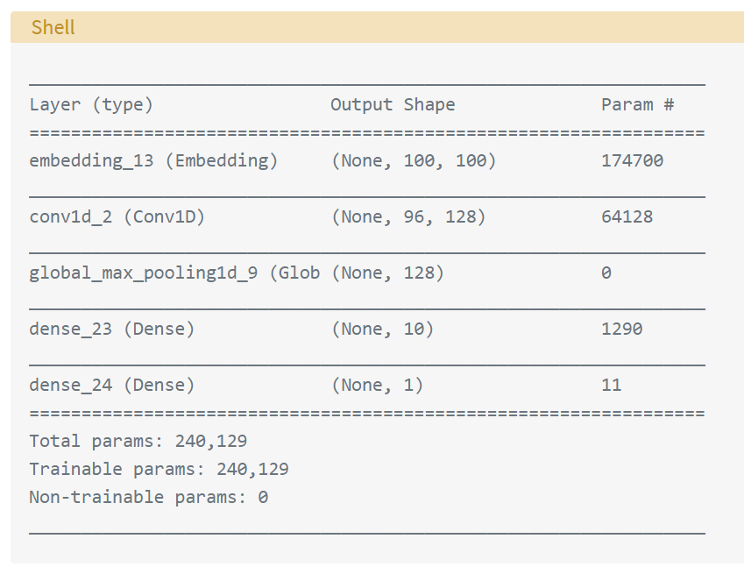

Slide 20
Comparison with RNN and HAN
Convolutional Neural Network (CNN)
Recurrent Neural Network (RNN)
Hierarchical Attention Network (HAN)

Slide 21
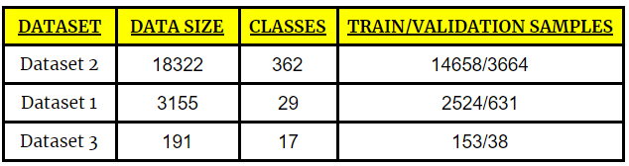
Dataset

Slide 22
Preprocessing
def clean_str(string): string = re.sub(r"\\", "", string) string = re.sub(r"\'", "", string) string = re.sub(r"\"", "", string) return string.strip().lower() texts = [];labels = [] for i in range(df.message.shape[0]): text = BeautifulSoup(df.message[i]) texts.append(clean_str(str(text.get_text().encode()))) for i in df['class']: labels.append(i)

Slide 23
The CNN model
sequence_input = Input(shape=(MAX_SEQUENCE_LENGTH,), dtype='int32') embedded_sequences = embedding_layer(sequence_input) l_cov1= Conv1D(128, 5, activation='relu')(embedded_sequences) l_pool1 = MaxPooling1D(5)(l_cov1) l_cov2 = Conv1D(128, 5, activation='relu')(l_pool1) l_pool2 = MaxPooling1D(5)(l_cov2) l_cov3 = Conv1D(128, 5, activation='relu')(l_pool2) l_pool3 = MaxPooling1D(35)(l_cov3) # global max pooling l_flat = Flatten()(l_pool3) l_dense = Dense(128, activation='relu')(l_flat) preds = Dense(len(macronum), activation='softmax')(l_dense)

Slide 24
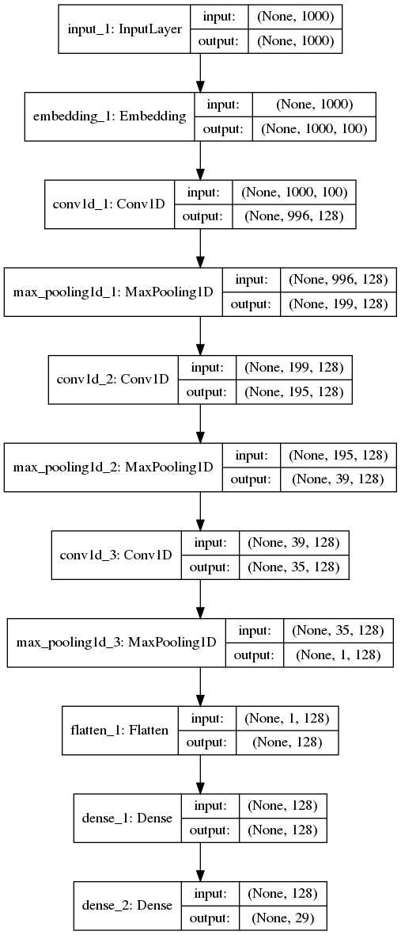
The model

Slide 25
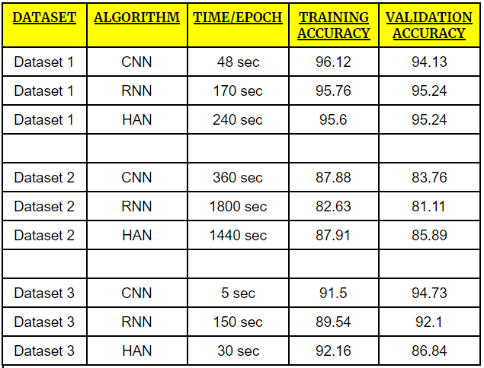
Results

Slide 26
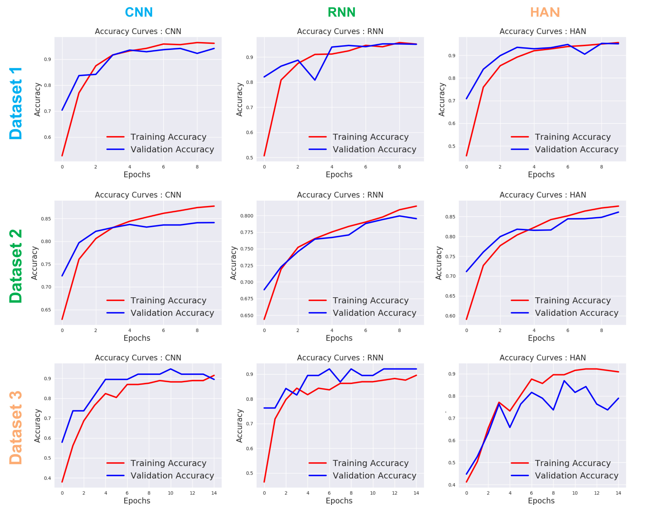

Slide 27
Observations 👇
Based on the above plots, CNN has achieved good validation accuracy with high consistency, also RNN & HAN have achieved high accuracy, but they are not that consistent throughout all the datasets.
RNN was found to be the worst architecture to implement for production ready scenarios.
CNN model has outperformed the other two models (RNN & HAN) in terms of training time; however HAN can perform better than CNN and RNN if we have a huge dataset.
For dataset 1 and dataset 2 where the training samples are more, HAN has achieved the best validation accuracy while when the training samples are very low, then HAN has not performed that good (dataset 3).
When training samples are less (dataset 3) CNN has achieved the best validation accuracy.

